Slide 1
Operations and Value Chain Management
Chapter
19

Slide 2
L E A R N I N G O U T L I N E
Follow this Learning Outline as you read and study this chapter.
What Is Operations Management and Why Is It Important?
  Explain what operations management is.
  Contrast manufacturing and services organizations.
  Describe managers’ role in improving productivity.
  Discuss the strategic role of operations management.
Value Chain Management
  Define value chain and value chain management.
  Describe the goal of value chain management.
  Discuss the requirements for successful value chain management.

Slide 3
L E A R N I N G O U T L I N E (cont’d)
Follow this Learning Outline as you read and study this chapter.
Value Chain Management (cont’d)
  Describe the benefits that result from value chain management.
  Explain the obstacles to value chain management.
Current Issues in Operations Management
  Discuss technology’s role in manufacturing.
  Tell some of the various quality dimensions.
  Explain ISO 9000 and Six Sigma.
  Describe mass customization and how operations management contributes to it.

Slide 4
What Is Operations Management?
Operations Management
  The design, operation, and control of the transformation process that converts such resources as labor and raw materials into goods and services that are sold to customers.
The Importance of Operations Management
  It encompasses both services and manufacturing.
  It is important in effectively and efficiently managing productivity.
  It plays a strategic role in an organization’s competitive success.

Slide 5
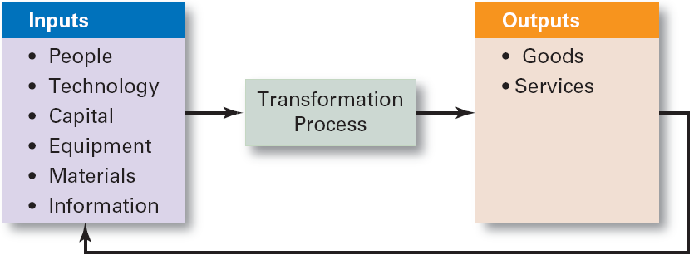
Exhibit 19–1 The Operations System

Slide 6
Manufacturing and Services
Manufacturing Organizations
  Use operations management in the transformation process of turning raw materials into physical goods.
Service Organizations
  Use operations management in creating nonphysical outputs in the form of services (the activities of employees interacting with customers).

Slide 7
Managing Productivity
Productivity
  The overall output of goods or services produced divided by the inputs needed to generate that output.
  A composite of people and operations variables.
Benefits of Increased Productivity
  Economic growth and development
  Higher wages and profits without inflation
  Increased competitive capability due to lower costs

Slide 8
Exhibit 19–2 Deming’s 14 Points for Improving Productivity
Plan for the long-term future.
Never be complacent concerning the quality of your product.
Establish statistical control over your production processes and require your suppliers to do so as well.
Deal with the best and fewest number of suppliers.
Find out whether your problems are confined to particular parts of the production process or stem from the overall process itself.
Train workers for the job that you are asking them to perform.
Raise the quality of your line supervisors.
Drive out fear.
Encourage departments to work closely together rather than to concentrate on departmental or divisional distinctions.
Do not adopt strictly numerical goals.
Require your workers to do quality work.
Train your employees to understand statistical methods.
Train your employees in new skills as the need arises.
Make top managers responsible for implementing these principles.
Source: W.E. Deming, “Improvement of Quality and Productivity Through Action by Management,” National Productivity Review, Winter 1981–1982, pp. 12–22. With permission. Copyright 1981 by Executive Enterprises, Inc., 22 West 21st St., New York, NY 10010-6904. All rights reserved.

Slide 9
Strategic Role of Operations Management
The era of modern manufacturing began in the U.S over 100 years ago.
After WWII, U.S. manufacturers’ focused on functional areas other than manufacturing.
By the 1970’s, foreign competitors’ integrated manufacturing technologies were producing quality goods at lower costs.
U.S manufacturers responded by investing in updated technology, restructuring organizations, and including production requirements in their strategic planning.

Slide 10
Value Chain Management
Value
  The performance characteristics, features and attributes, and any other aspects of goods and services for which customers are willing to give up resources (i.e., spend money).
The Value Chain
  The entire series of organizational work activities that add value at each step beginning with the processing of raw materials and ending with the finished product in the hands of end users.

Slide 11
Value Chain Management (cont’d)
What is Value Chain Management?
  The process of managing the entire sequence of integrated activities and information about product flows along the entire value chain.
Goal of Value Chain Management
  To create a value chain strategy that fully integrates all members into a seamless chain that meets and exceeds customers’ needs and creates the highest value for the customer.

Slide 12
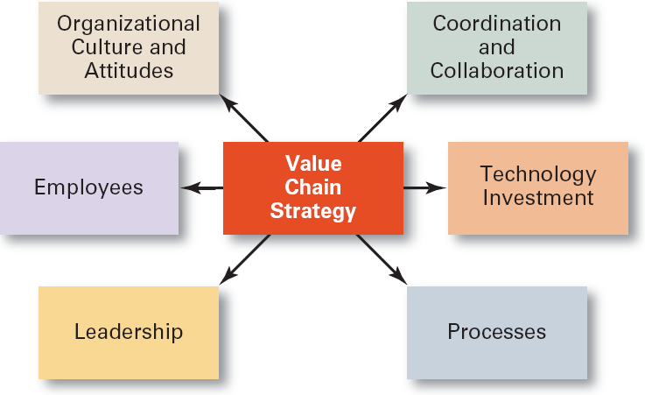
Exhibit 19–3 Six Requirements for Successful Value Chain Management

Slide 13
Value Chain Management (cont’d)
Requirements for Value Chain Management
  A new business model incorporating:
    Coordination and collaboration
    Investment in information technology
    Changes in organizational processes
    Committed leadership
    Flexible jobs and adaptable, capable employees
    A supportive organizational culture and attitudes

Slide 14
Benefits of Value Chain Management
Improved Procurement
Improved Logistics
Benefits of
Value Change Management
Enhanced Customer Order Management
Improved Product Development

Slide 15
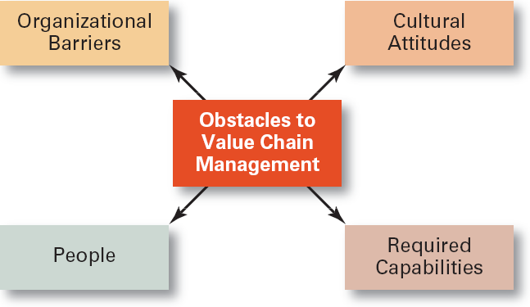
Exhibit 19–4 Obstacles to Successful Value Chain Management

Slide 16
Value Chain Management (cont’d)
Obstacles to Value Chain Management
  Organizational barriers
    Refusal or reluctance to share information
    Reluctance to shake up the status quo
    Security issues
  Cultural attitudes
    Lack of trust and too much trust
    Fear of loss of decision-making power
  Required capabilities
    Lacking or failing to develop the requisite value chain management skills

Slide 17
Value Chain Management (cont’d)
Obstacles to Value Chain Management (cont’d)
  People
    Lacking commitment to do whatever it takes
    Refusing to be flexible in meeting the demands of a changing situation
    Not being motivated to perform at a high level
    Lack of trained managers to lead value chain initiatives

Slide 18
Current Operations Management Issues
Technology’s Role in Manufacturing
  Increased automation and integration of production facilities with business systems to control costs.
    Predictive maintenance, remote diagnostics, and utility cost savings
The Concept of Quality
  The ability of a product or service to reliably do what it’s supposed to do and to satisfy customer expectations.

Slide 19
Current Issues… (cont’d)
Quality Initiatives
  Planning for quality
  Organizing and leading for quality
  Controlling for quality
Quality Goals
  ISO 9000 certification
  Six Sigma standards

Slide 20
Exhibit 19–5 Product Quality Dimensions
Performance—Operating characteristics
Features—Important special characteristics
Flexibility—Meeting operating specifications over some period of time
Durability—Amount of use before performance deteriorates
Conformance—Match with preestablished standards
Serviceability—Ease and speed of repair or normal service
Aesthetics—How a product looks and feels
Perceived quality—Subjective assessment of characteristics (product image)
Sources: Adapted from J.W. Dean, Jr., and J.R. Evans, Total Quality: Management, Organization and Society (St. Paul, MN: West Publishing Company, 1994); H.V. Roberts and B.F. Sergesketter, Quality is Personal (New York: The Free Press, 1993): D. Garvin, Managed Quality: The Strategic and Competitive Edge (New York: The Free Press, 1988); and M.A. Hitt, R.D. Ireland, and R.E. Hoskisson, Strategic Management, 4th ed. (Cincinnati, OH: SouthWestern, 2001), p. 211.

Slide 21
Exhibit 19–5 (cont’d) Service Quality Dimensions
Timeliness—Performed in promised period of time
Courtesy—Performed cheerfully
Consistency—Giving all customers similar experiences each time
Convenience—Accessibility to customers
Completeness—Fully serviced, as required
Accuracy—Performed correctly each time
Sources: Adapted from J.W. Dean, Jr., and J.R. Evans, Total Quality: Management, Organization and Society (St. Paul, MN: West Publishing Company, 1994); H.V. Roberts and B.F. Sergesketter, Quality is Personal (New York: The Free Press, 1993): D. Garvin, Managed Quality: The Strategic and Competitive Edge (New York: The Free Press, 1988); and M.A. Hitt, R.D. Ireland, and R.E. Hoskisson, Strategic Management, 4th ed. (Cincinnati, OH: SouthWestern, 2001), p. 211.

Slide 22
Current Issues… (cont’d)
Mass Customization
  Is a design-to-order concept that provides consumers with a product when, where, and how they want it.
  Makes heavy use of technology (flexible manufacturing techniques) and engages in a continual dialogue with customers.
Benefits of Mass Customization
  Creates an important relationship between the firm and the customer in providing loyalty-building value to the customer and in garnering valuable market information for the firm.

Slide 23
Terms to Know
operations management
manufacturing organizations
service organizations
productivity
value
value chain
value chain management
organizational processes
intellectual property
quality
ISO 9000
Six Sigma
mass customization

